Slide 1
Configuration Guide
(IDE – Eclipse 3.5
VM Arguments)
2009. 08. 19
CODELABOR
Shin Sang Jae (codelabor@gmail.com)

Slide 2

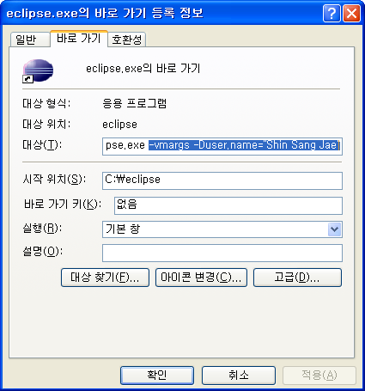
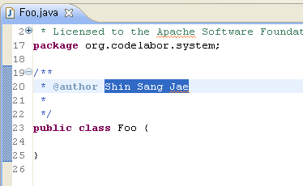
Author
User Name
Select Shortcut and right click
Add VM Arguments
  -vmargs –Duser.name=“User Name”
Restart Eclipse
Create New File

